Slide 1
Marketing Operations
Survey Feedback/Hot Topics
Phil Cuff
5th May 2024

Slide 2
Agenda
Welcome
Best Practice: Survey Feedback/Hot Topics
Open Q&A/Discussion

Slide 3

Marketing Operations Open Office Hours
Get your questions answered by the marketing automation team. MA Open Office Hours are held monthly with the following agenda:
Learn about a tip or best practice
Ask a question – Pre-submit your questions here or ask during the office hours
Learn how to leverage IQVIA’s marketing systems and processes most effectively
Action: Sign up here, if you need to be added to the outlook invite
Reminder: Save your questions for the end or enter in the chat. We will address as many as we can!

Slide 4
Where can I find the email templates?

Slide 5
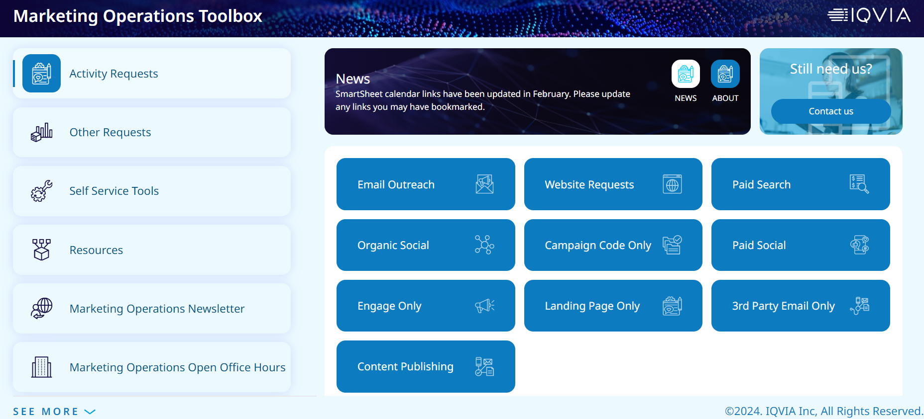
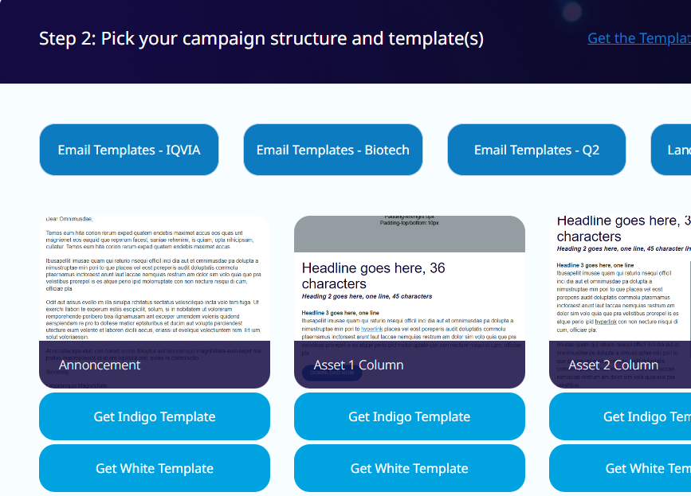
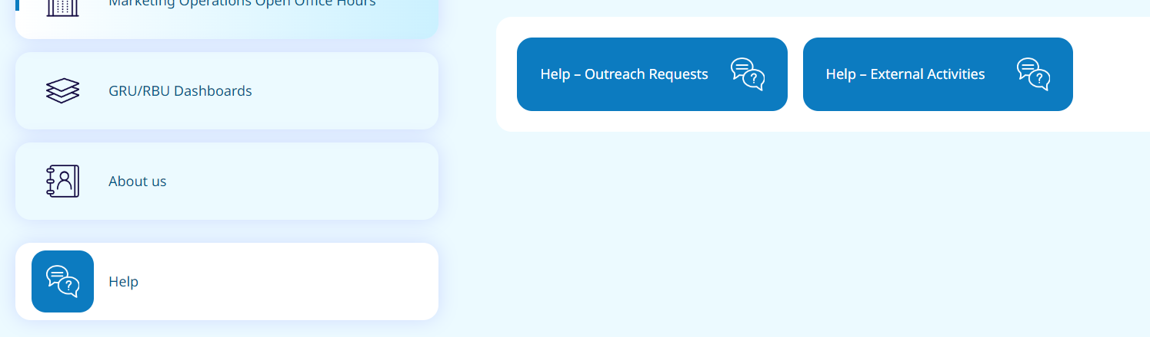
Eloqua Email and Landing Page Templates
Our suite of email templates can be found on the Marketing Operations Toolbox within the Help Section (click on see more at the bottom of the page to access the Help section) and by clicking on the Help – Outreach Requests CTA
Scroll down to Step 2: Pick your Campaign Structure and templates
Click on the appropriate Templates CTA
You can then view and select to download word versions of the templates

Slide 6
What is the Marketer Dashboard and How can I access it?

Slide 7
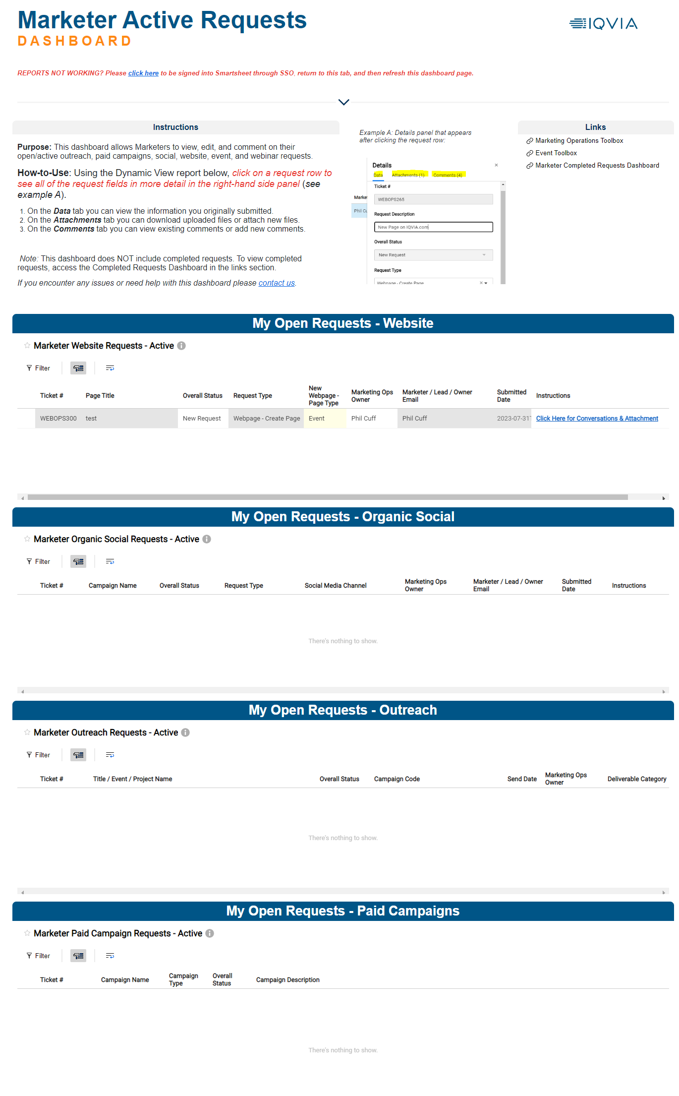
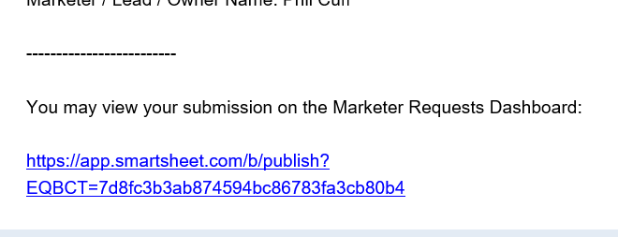
Marketer Dashboard
Introduced in 2023 and is a single location to view and manage your active requests including event requests
Should be used to manage conversations relating to the request
Can be used to add attachments
Can be accessed from any of the SmartSheet notifications you receive
We will be looking to add a link to the Marketer Dashboard onto the Toolbox
A basic guide can be found on the Toolbox within the Training section under Resources

Slide 8
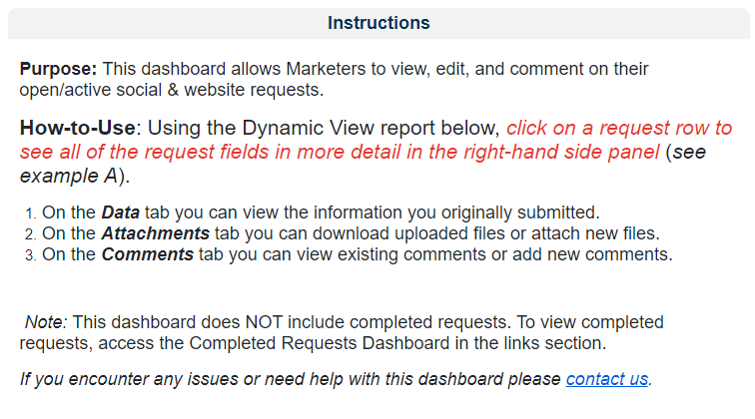
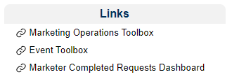

Marketer Dashboard Overview
https://app.smartsheet.com/b/publish?EQBCT=7d8fc3b3ab874594bc86783fa3cb80b4
The dashboard allows you to view all of your open requests for any of the Marketing Operations intake forms
The introduction section explains how you can use the dashboard
There is also a links section on the right which links to the dashboard for completed requests
Each intake/request type has it’s own row/section and you can filter your requests within each of these sections

Slide 9
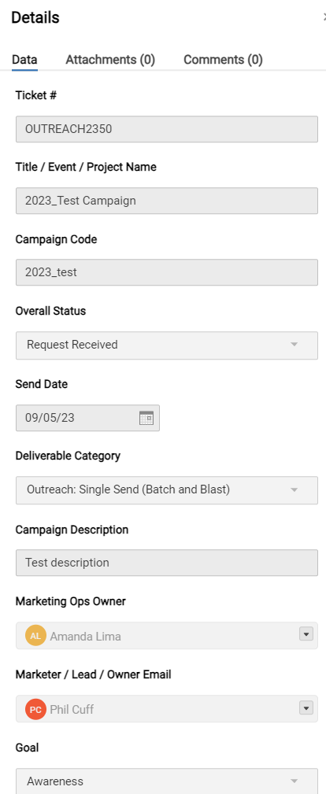
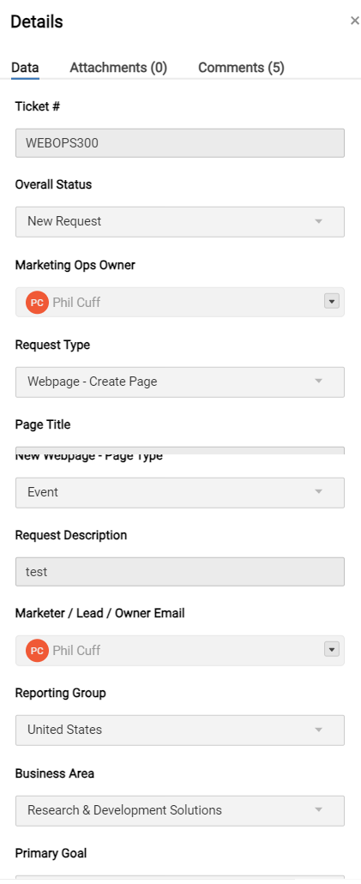
Viewing the details
View details, add attachments, add/reply to comments
When you click on any of the requests you can view the details of that request.
You can also add attachments and make/reply to comments which will be viewed by the Marketing ops team

Slide 10
What are the different types of forms and landing pages?

Slide 11


Types of Forms
MQL
Non MQL
Linked to Inside Sales
Has additional processing steps to create an MQL task
Has additional checkbox and qualifying question as well as several hidden fields
Should not be used for gated content
More basic
Not linked to Inside Sales
Fewer hidden fields and processing steps
Can be used for gated content

Slide 12
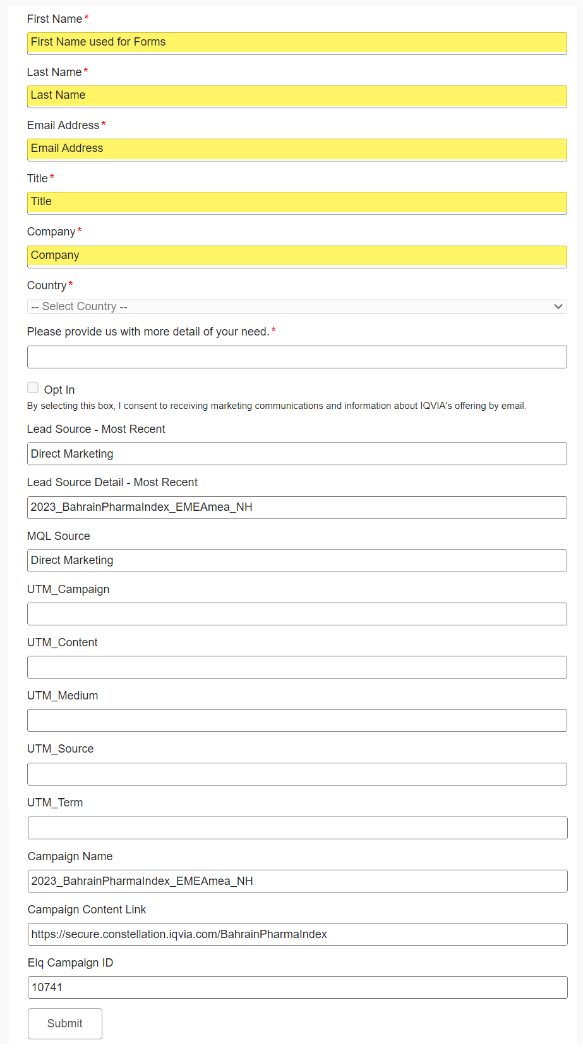
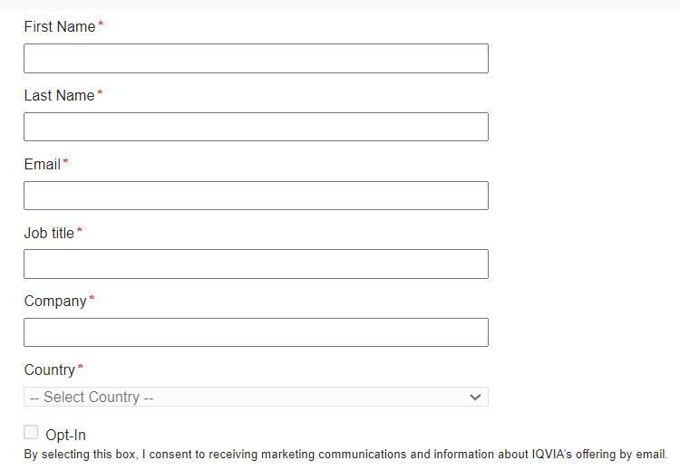
Types of Forms
MQL forms there is an additional field of ‘Please provide us with more detail of your need’ which is required and is important for the Inside Sales triage process
Generally, forms will have 6-7 required fields
MQL Form
Non MQL Form
Hidden Fields
Non-MQL form is the more basic form and isn’t linked to Inside Sales. This form would be used for gated content on a landing page.

Slide 13
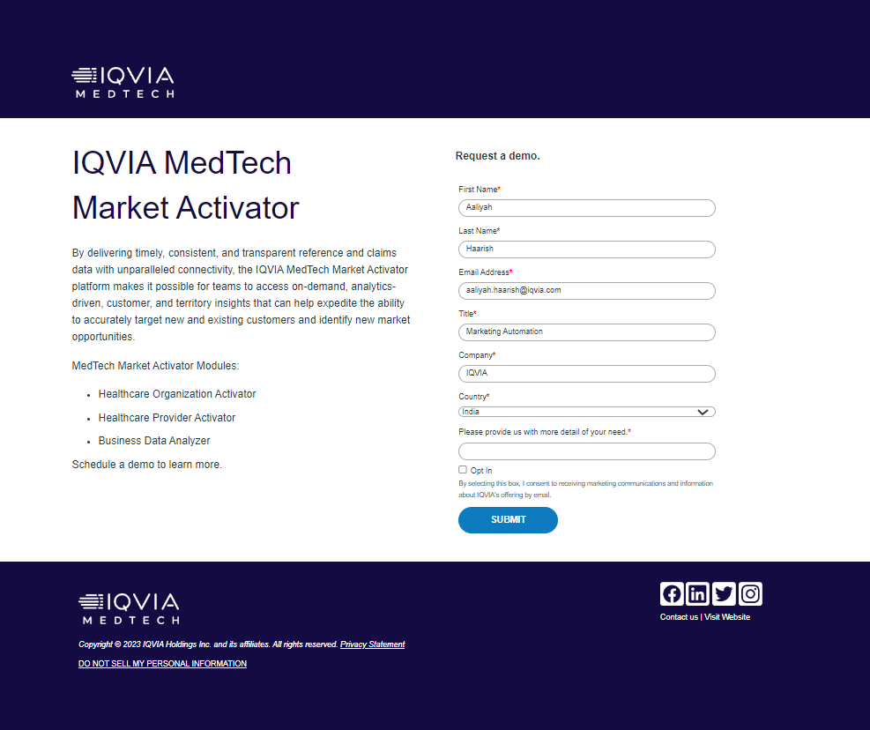
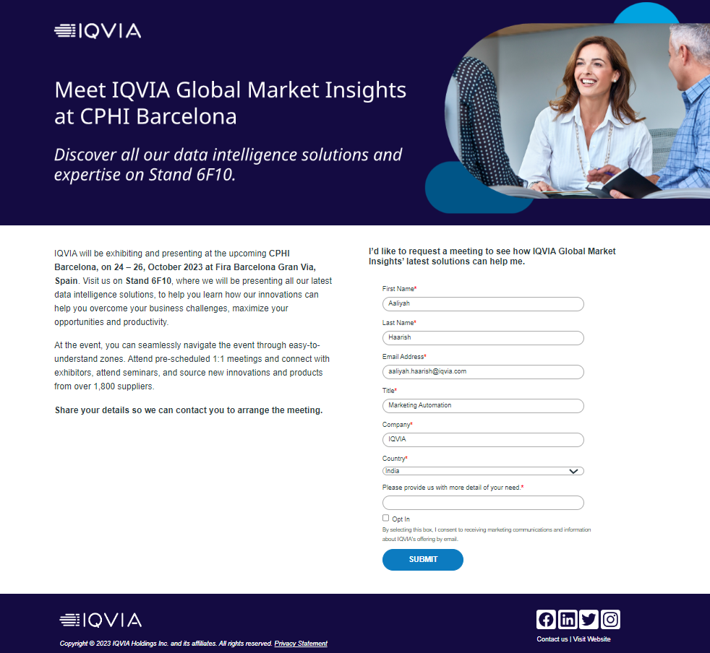
What is a Landing page?
Landing Pages are treated as part of an email campaign or standalone assets.
Landing pages are standalone pages that can be used to present additional information, including hosting a form or and asset
Landing page templates can be found in the help section of the Toolbox

Slide 14
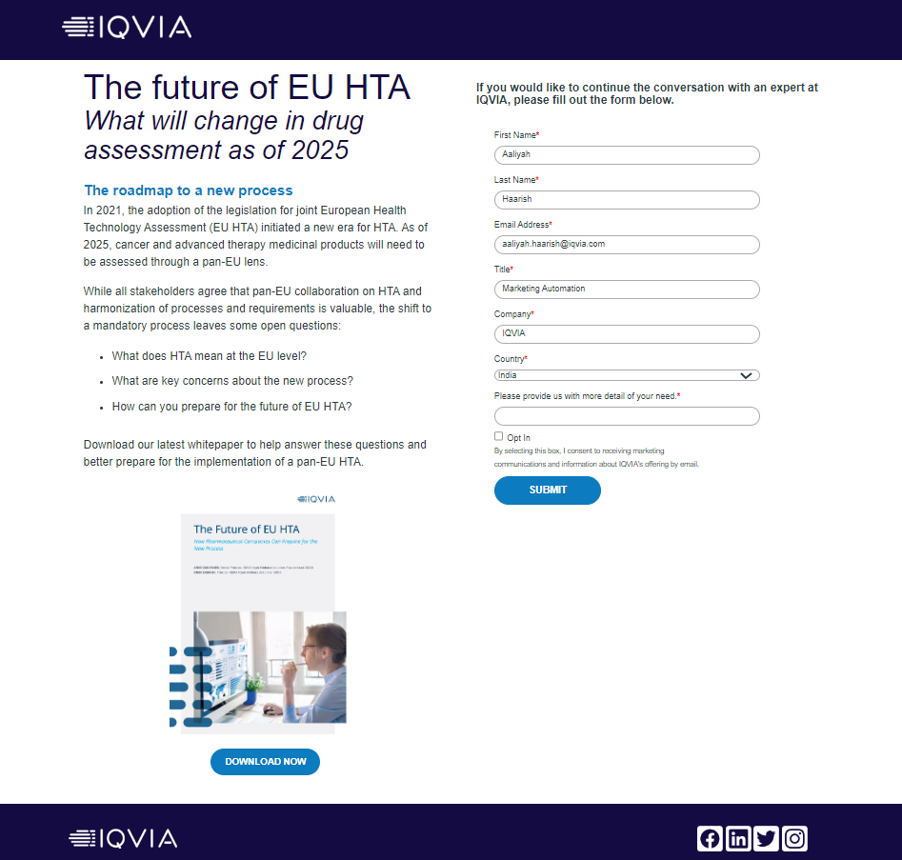
Hybrid Landing page
Hybrid landing page is a combination of offering access to any resources like, whitepapers, fact sheets etc along with a hybrid or an MQL form.
This can be used as an alternative for gated pages.
A Hybrid landing page can be created either with a hybrid form or a standard MQL form

Slide 15
Where can I find out more information about Segmentation and exclusions?

Slide 16
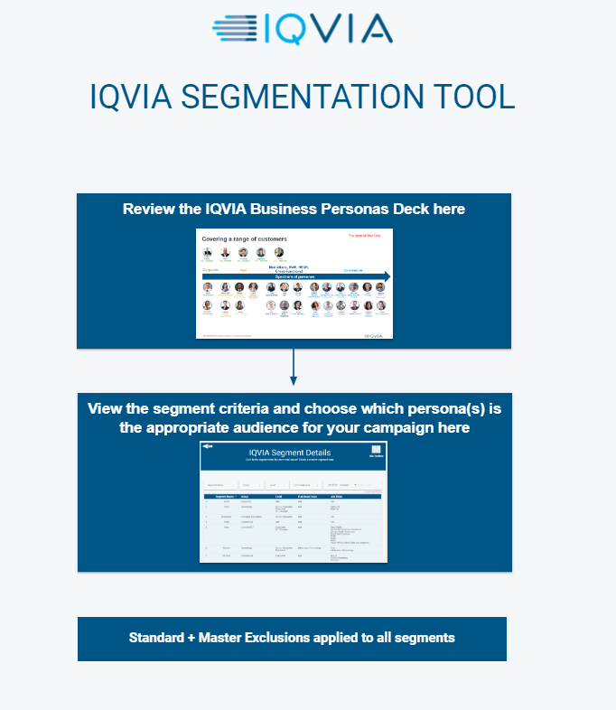
IQVIA Segmentation Tool
The IQVIA Segmentation Tool is available within the Self Service Tools section of the Toolbox
You can use this tool to:-
Review the IQVIA Business Personas Deck
View the segment criteria
Review the Standard and Master Exclusions
You can also view what the difference is between Standard and Master exclusions
Additional information on segmentation may be found in previous Open Office Hours presentation which are also located on the Toolbox

Slide 17
What work do you do to improve database quality?

Slide 18
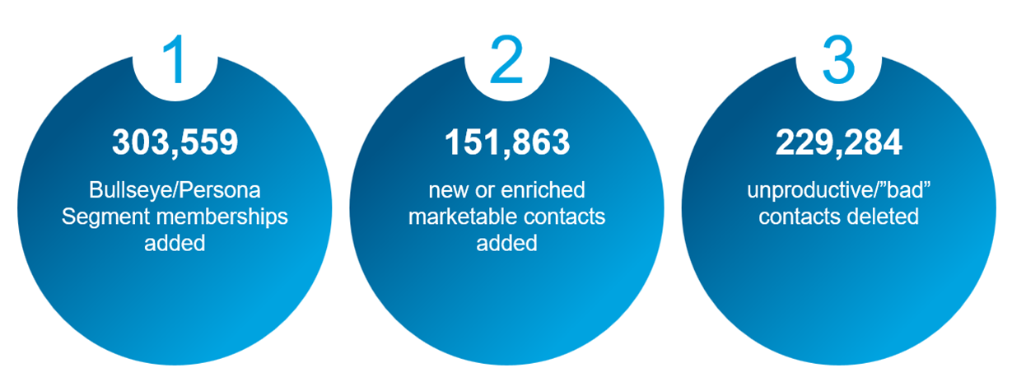
Marketing Data Hygiene Strategy
A continuous program aimed at enhancing our marketing database by adding & enriching new contacts while simultaneously removing non-productive ones
2023 Key Metrics
April 2024
Added 162,193 new contacts, primarily Senior Executives and Executives, ready for marketing campaigns. These contacts were carefully chosen to align with our marketing requirements, considering key aspects such as job title, level and industry and were procured through ZoomInfo. Here are some key details:
Over 105,000 of these new Contacts instantly qualified for membership in an existing Persona or Bullseye.
The geographical distribution of these contacts is global, with nearly half of them located outside the US/Canada.
To prevent duplication, existing leads and contacts were suppressed.
Monthly: Add new Contacts & enrich existing Contacts

Slide 19
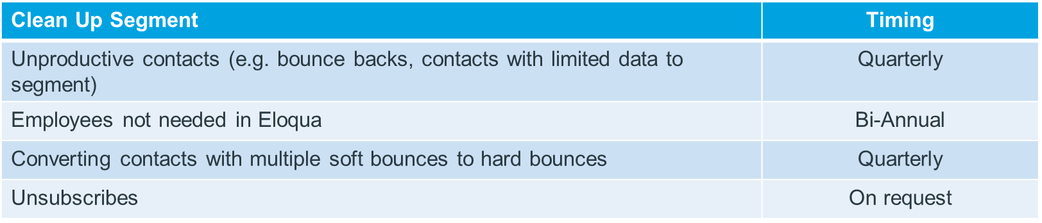
Marketing Data Hygiene Strategy
Data Cleansing
Objective
As part of a comprehensive Data Hygiene strategy, develop criteria and a systematic process to cleanse unproductive/‘bad’ records (Leads & Contacts) from Eloqua and/or CRM quarterly.
Benefits
Reduce Costs – monitor & manage record counts to stay within contractual thresholds for Eloqua
Improve Email Deliverability – limit bounce backs and emails marked as spam, avoid blacklisting by ISPs
Accurate Analytics – better idea of how effective outreach is, likely improve open/click rates
Why updating both platforms is ideal
Keep data similar between platforms
Ensure that ‘bad’ records are not re-introduced into Eloqua from CRM
Exclusions: Records that will not be deleted
Contacts associated with opportunities
Contact/Leads associated with MQLS

Slide 20
How can I provide feedback?

Slide 21
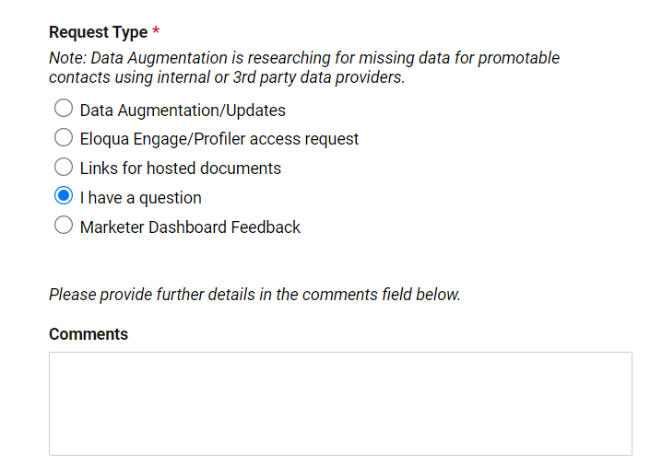
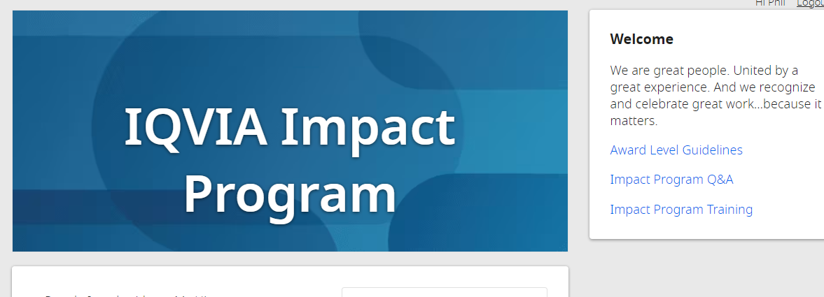
Tools for providing feedback
You may want to provide feedback on our services or have suggestions for improvements
Contact Us form has the option to provide feedback specifically about the dashboard or if you want to provide other feedback you can choose ‘I have a question’ as the request type and provide details in the comments section
*New feedback option coming soon to provide specific types of feedback including on team members
IQVIA Impact Program
Feedback is always reviewed and appreciated

Slide 22
Where can I go for help?

Slide 23
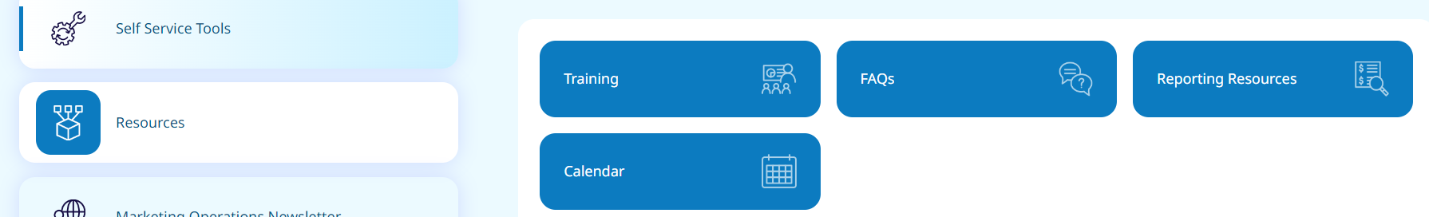
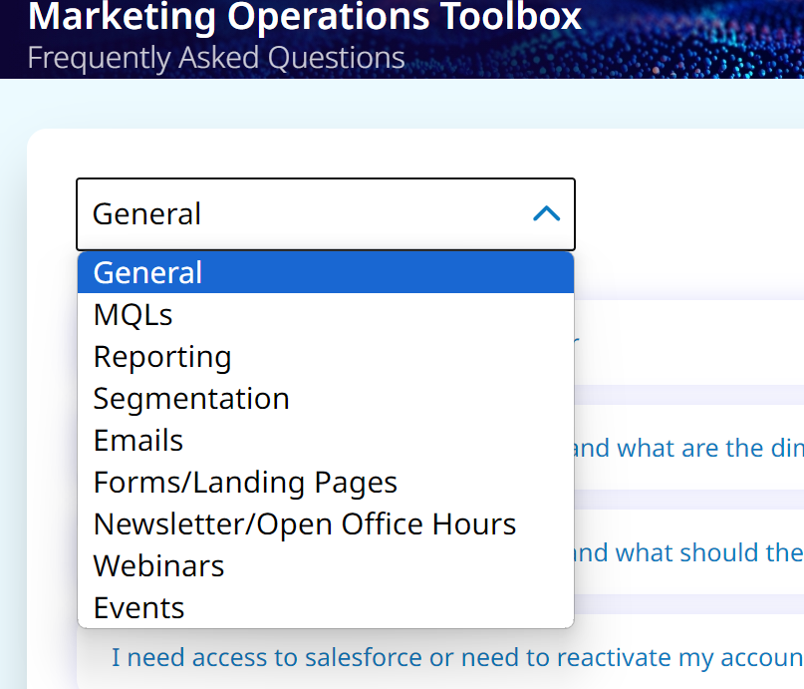
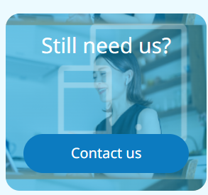
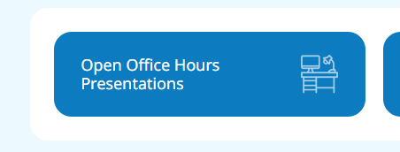
Available resources
Abundance of resources on the Marketing Operations Toolbox
FAQs
Help
Open Office Hours presentations
Reporting Resources
Training
Contact Us
Monthly Open Office Hours sessions

Slide 24
Who does what in Marketing Operations?

Slide 25
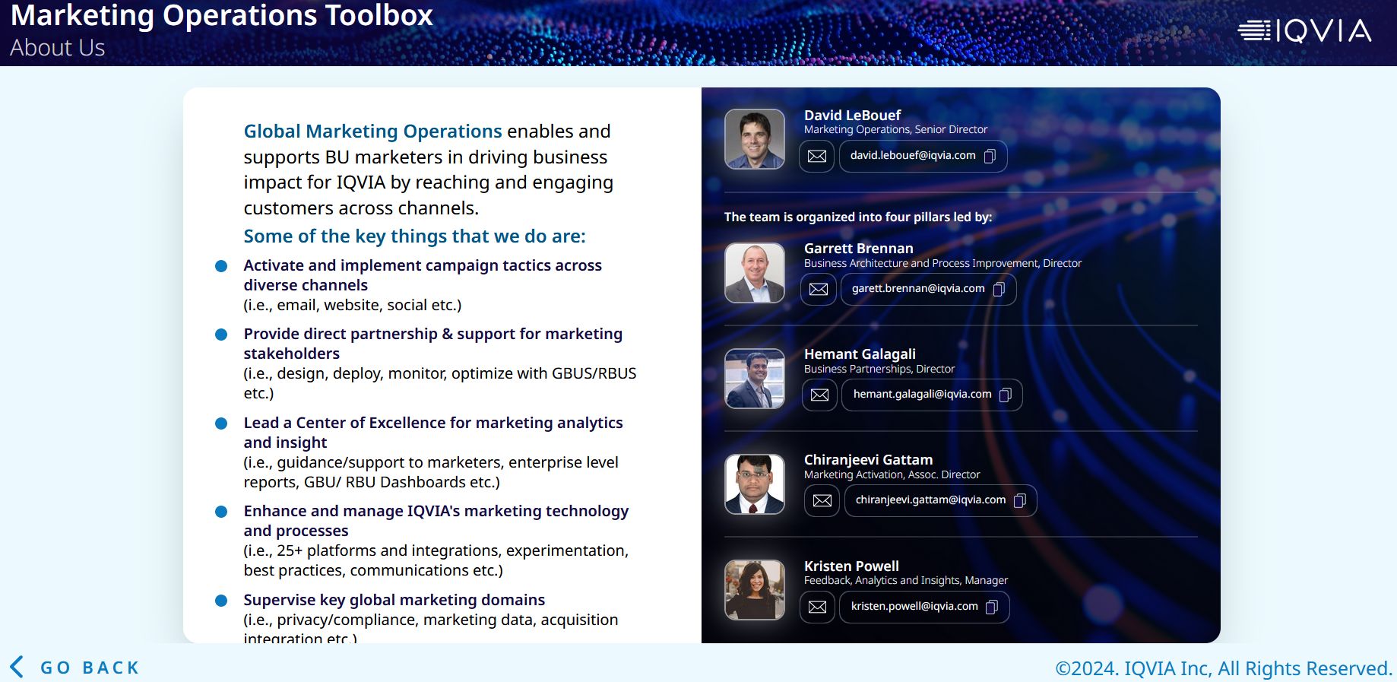
Marketing Operations Team
About Us section of the Toolbox
More detailed breakdown of team and responsibilities including org chart coming soon

Slide 26
Thank You

